Slide 1
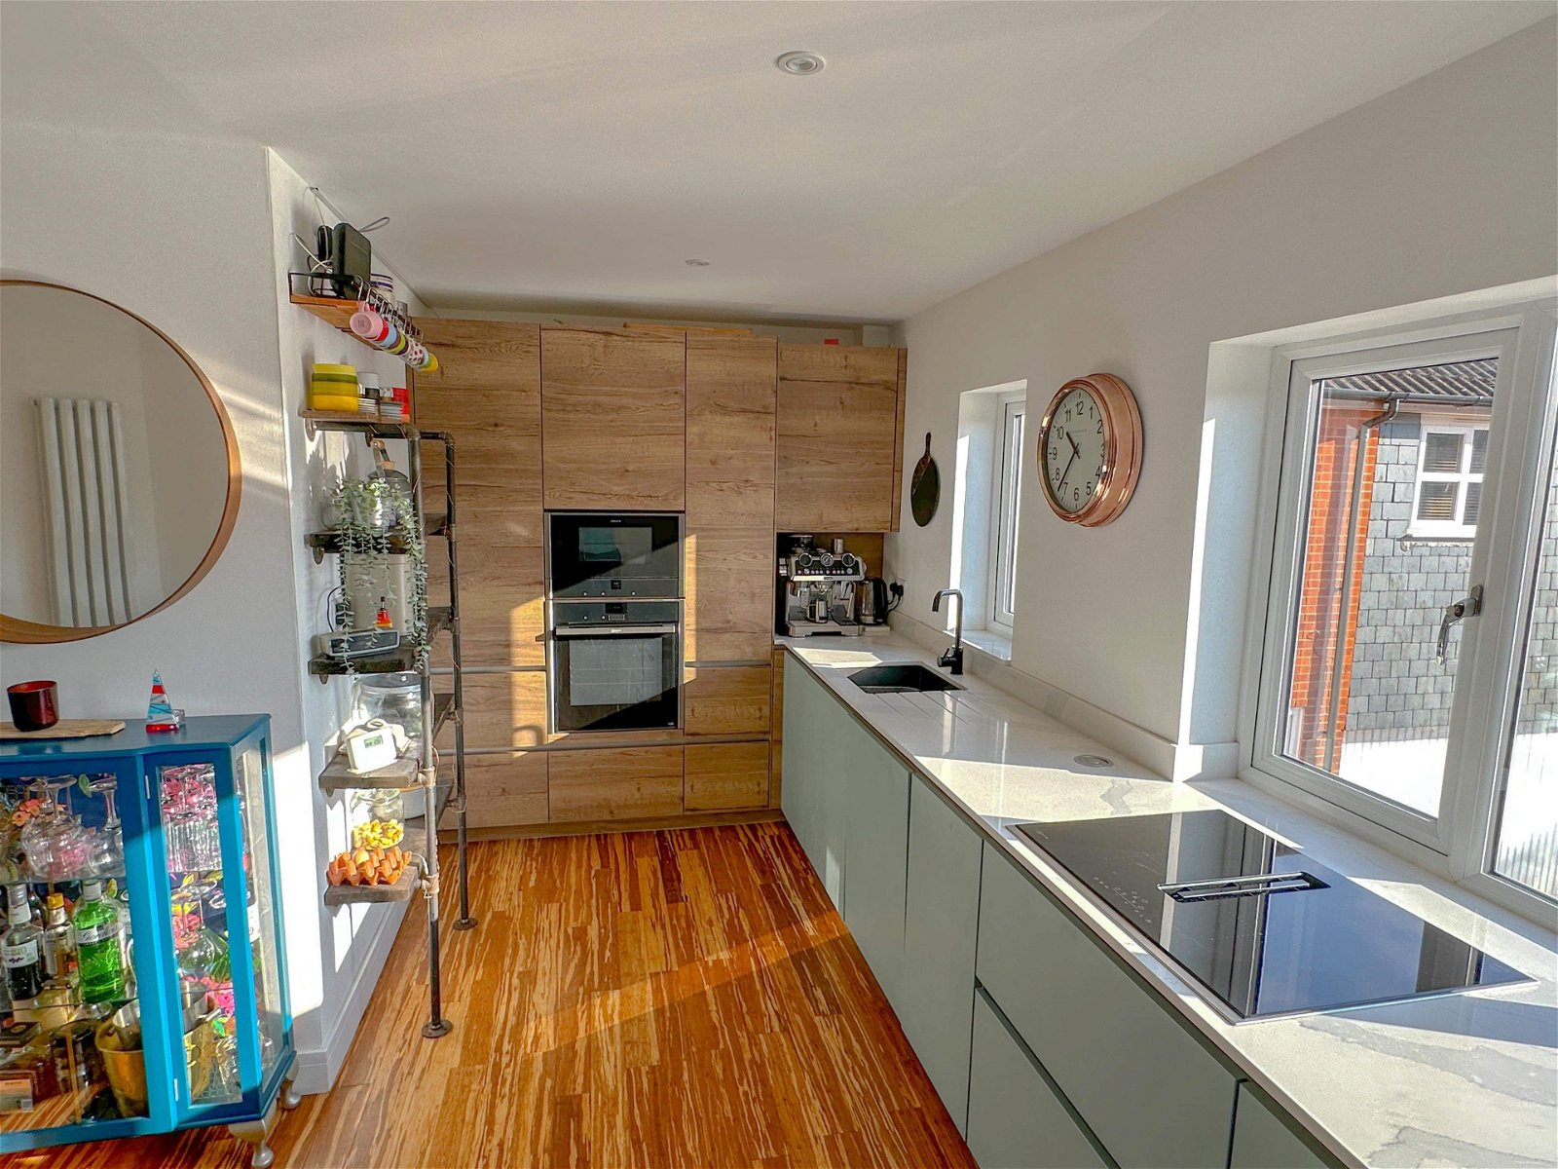
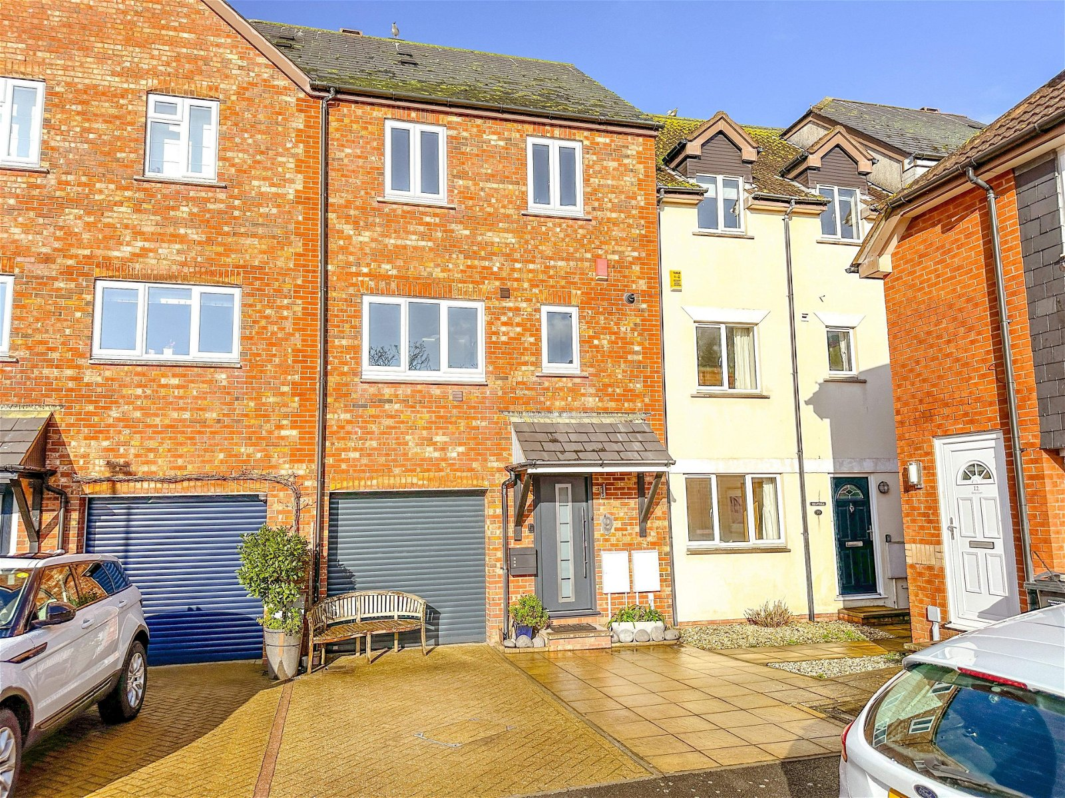
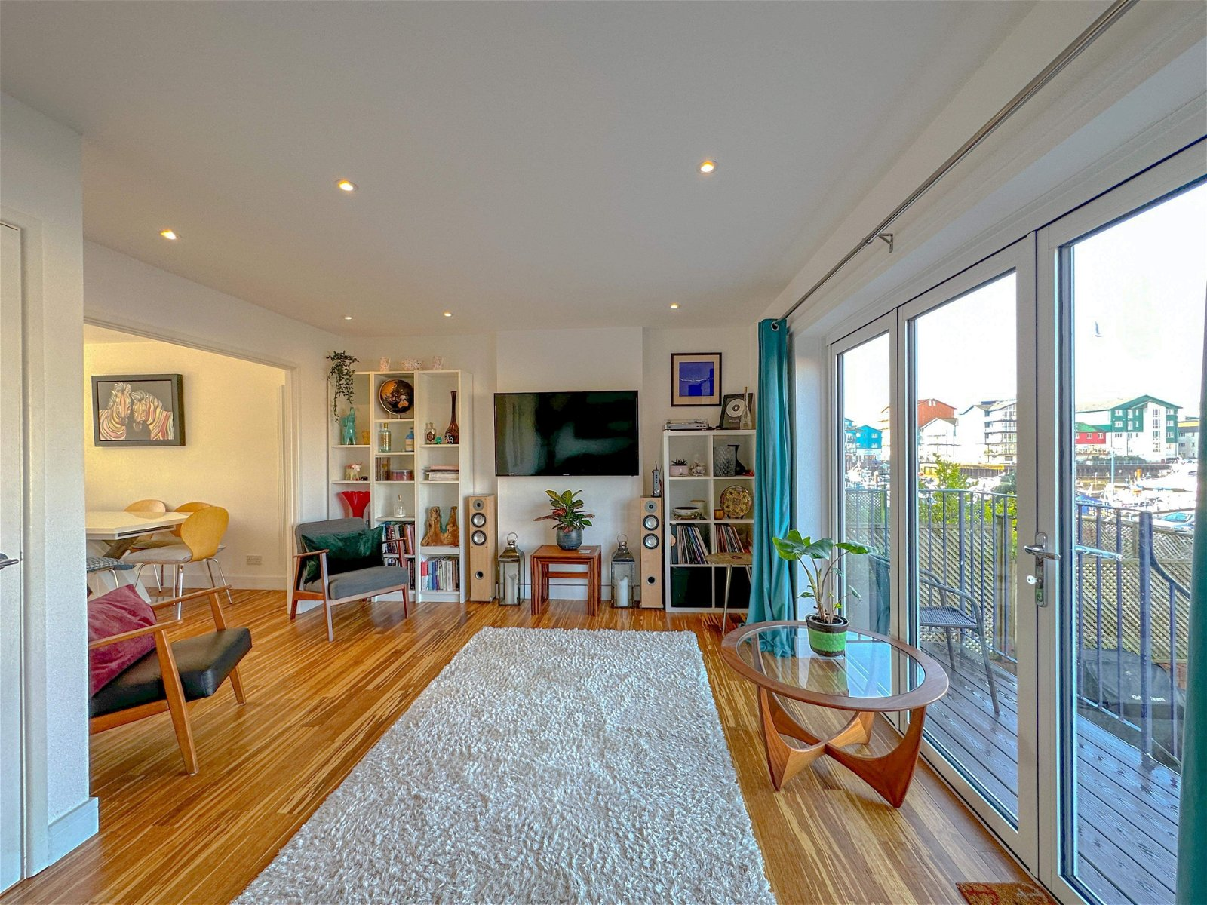
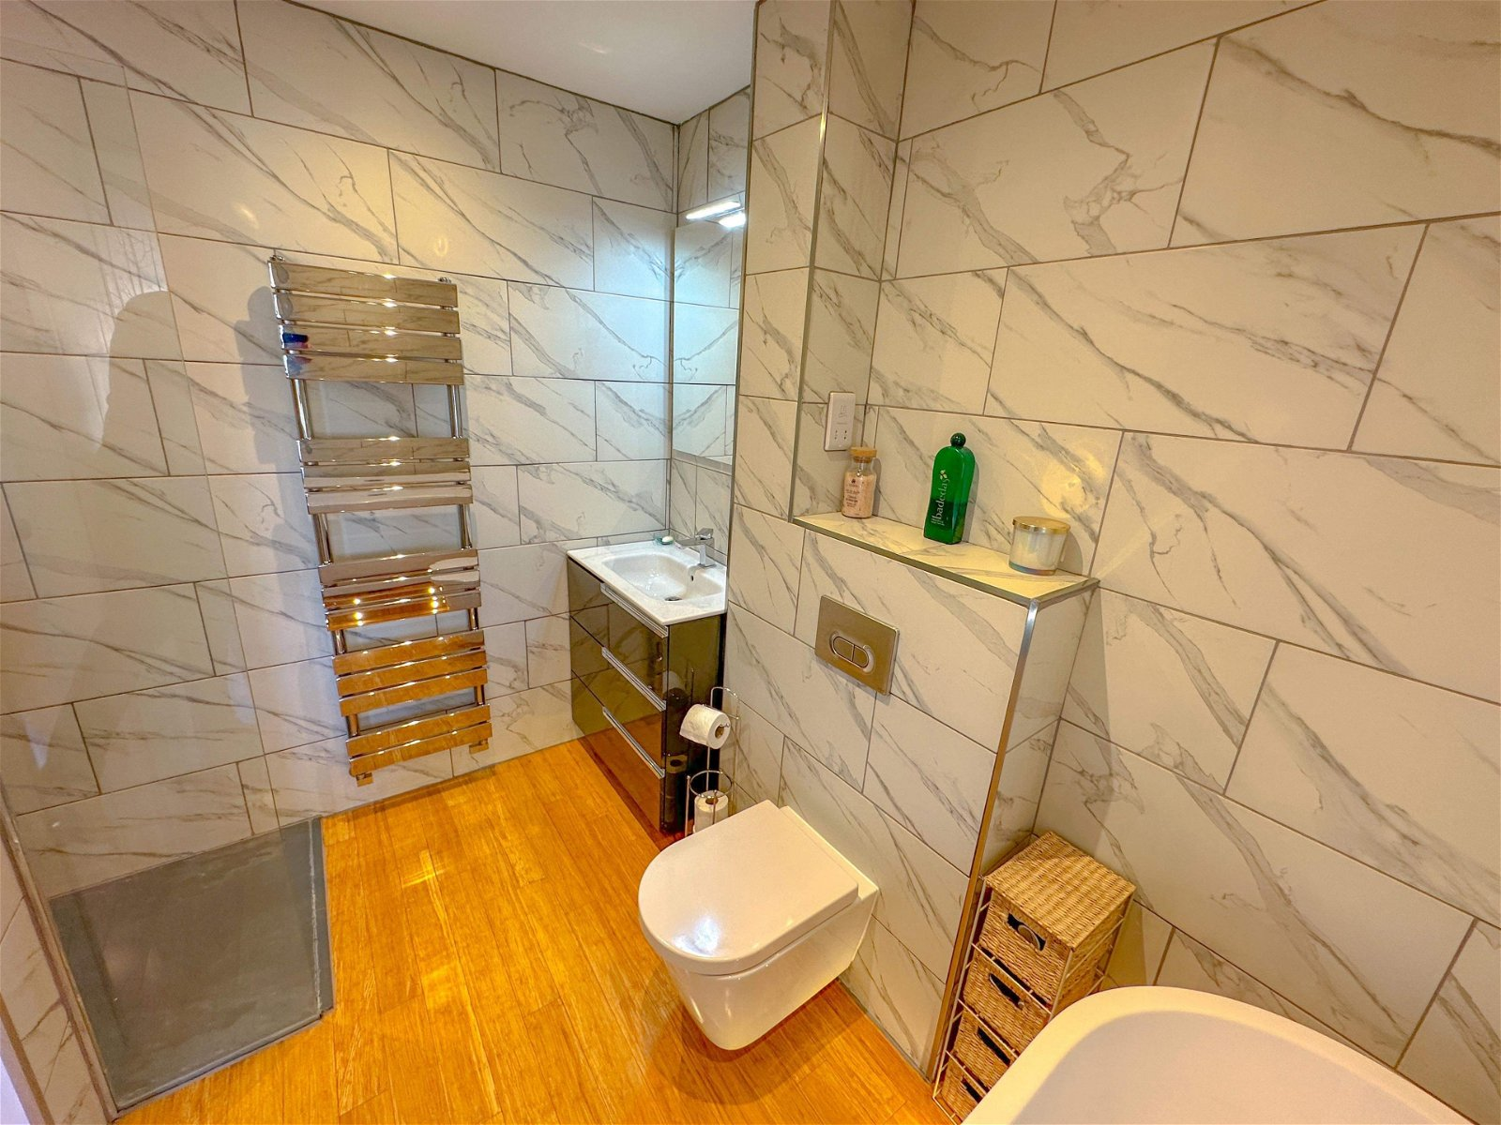
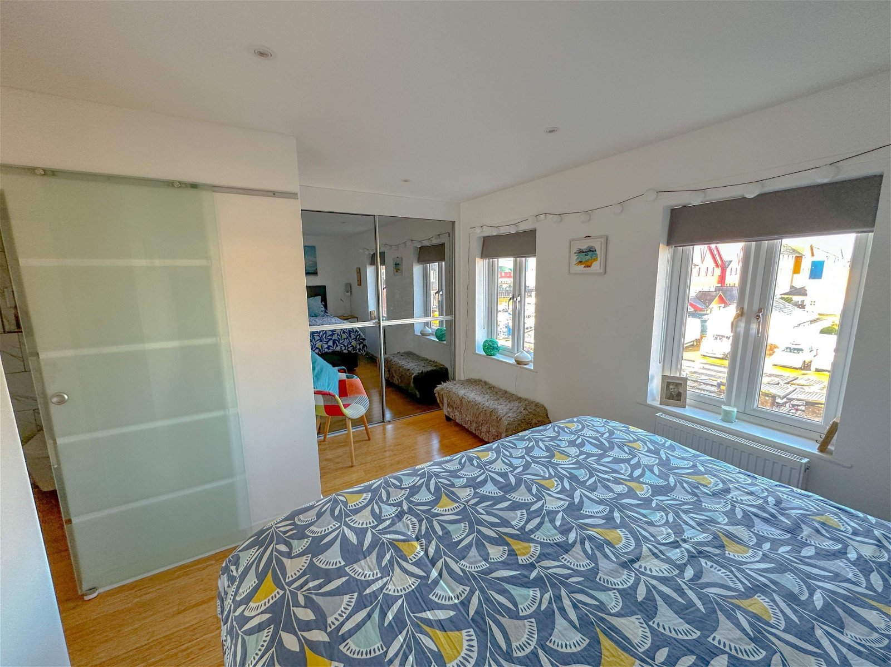
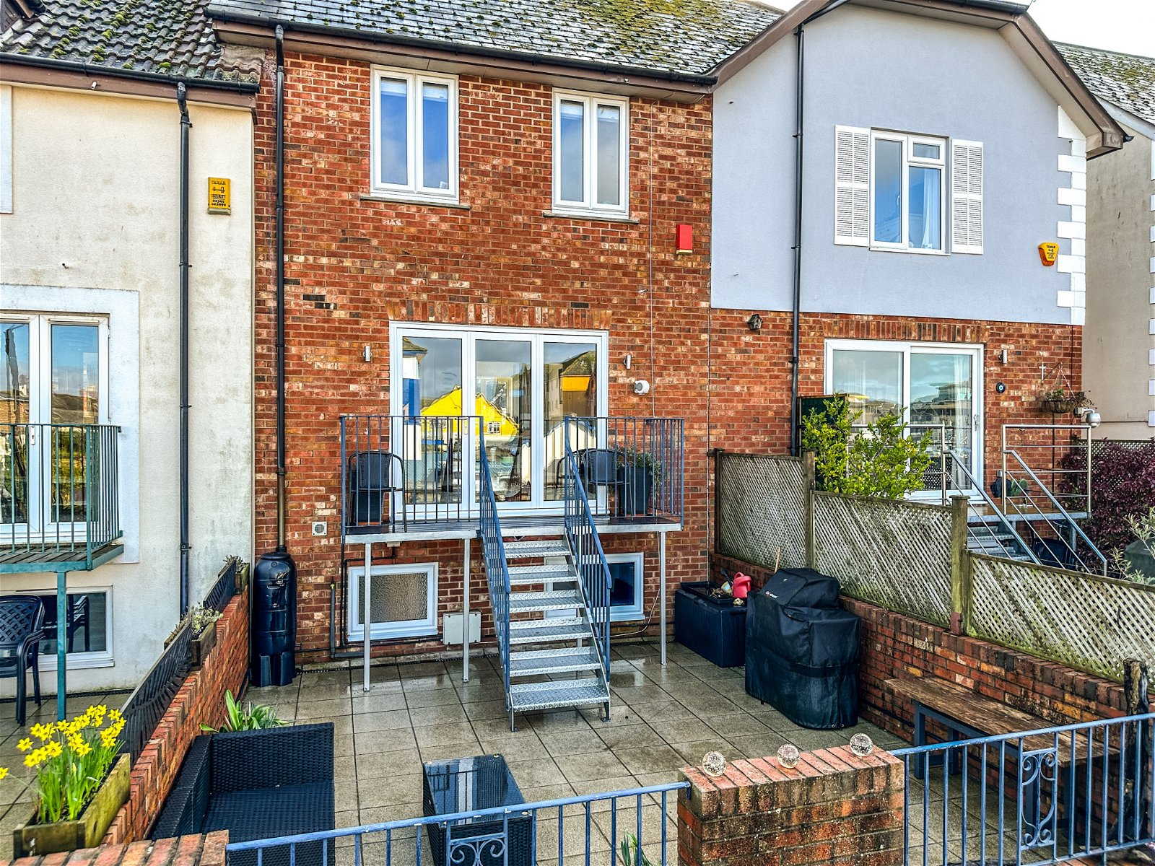
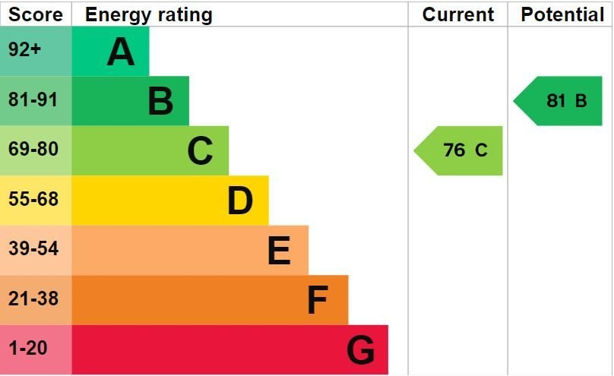
www.pennys.net
9 Sharps Court, Exmouth, EX8 1DT
GUIDE PRICE £625,000
TENURE Freehold
A Stunning Town House Which Has Been Refurbished To A High Standard Located By Exmouth Marina With Splendid Outlook With Patio Sun Terrace And Garage
Bright & Spacious High Quality Accommodation • Solid Oak And Bamboo Wood Flooring And Modern Newly Fitted Carpets • Four Bedrooms •
Modern Ground Floor Shower Room & Second Floor En-Suite Bathroom/Shower Room •
Quality Kitchen/Dining Room • Gas Central Heating • Modern uPVC Double Glazed Windows • Viewing Strongly Recommended •
Pennys Estate Agents Limited for themselves and for the vendor of this property whose agents they are give notice that:- (1) These particulars do not constitute any part of an offer or a contract. (2) All statements contained in these particulars are made without responsibility on the part of Pennys Estate Agents Limited. (3) None of the statements contained in these particulars are to be relied upon as a statement or representation of fact. (4) Any intending purchaser must satisfy himself/herself by inspection or otherwise as to the correctness of each of the statements contained in these particulars. (5) The vendor does not make or give and neither do Pennys Estate Agents Limited nor any person in their employment has any authority to make or give any representation or warranty whatever in relation to this property.
PENNYS ESTATE AGENTS
2 Rolle House, Rolle Street, Exmouth, Devon, EX8 2SN
Tel: 01395 264111 EMail: help@pennys.net

Slide 2
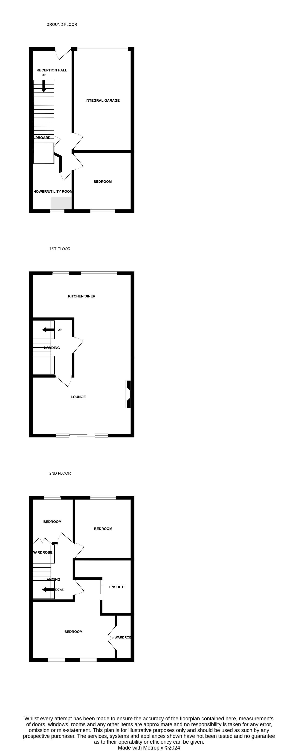
9 Sharps Court, Exmouth, EX8 1DT
A fine example of a townhouse that has views towards Exmouth Marina and is within walking distance of Exmouth beach and the town centre. The property recently has undergone a programme of refurbishment and offers stunning and well-planned accommodation comprising four good size bedrooms including main bedroom with stylish and spacious en-suite and a ground floor bedroom with access to a shower room and utility. The open plan living space offers a high quality premium 'Linen' German kitchen/dining room and a spacious living room with slide and glide doors leading to a sunny rear garden comprising of a large private patio and sun terrace, with views towards the marina to the rear of the property with integral storage beneath. THE ACCOMMODATION COMPRISES:
ENTRANCE HALL: Horman Steel front door; understairs cupboard; hard wood oak flooring; stylish upright radiator: stairs to first floor landing. BEDROOM FOUR: 2.84m x 2.9m (9'4" x 9'6") uPVC double glazed window to rear aspect; radiator; electric underfloor heating. SHOWER/UTILITY ROOM: 2.92m x 2.84m (9'7" x 9'4") A newly fitted suite with uPVC double glazed frosted window to rear aspect; walk-in shower cubicle; low level toilet; vanity wash hand basin; utility area with plumbing for a washing machine; tumble dryer space; electric underfloor heating. FIRST FLOOR LANDING: Stairs with glass and oak balustrade leading from hallway to kitchen/dining room and living room. KITCHEN/DINING ROOM: 4.95m x 4.06m (16'3" x 13'4") A stunning premium 'Linen' German kitchen with Neff induction hob with integrated ventilating system oven and microwave : Siemens integrated dishwasher; progress integrated fridge and freezer; horizon stone (Calcutta Light) worktop surfaces; wall mounted ‘Ideal’ boiler: solid bamboo flooring: uPVC double glazed window to front aspect. DINING AREA: Double glazed window to front aspect; stylish upright radiator. LOUNGE: 4.93m x 3.73m (16'2" x 12'3") Slide and glide double glazed doors and windows with opening onto sun terrace with views to the Marina; LED ceiling spotlighting; stylish upright radiator; solid Bamboo flooring. FIRST FLOOR LANDING: Stairs leading to SECOND FLOOR.
2ND FLOOR LANDING: Doors leading to: Loft hatch with integrated ladder to boarded insulated loft.
BEDROOM ONE: 4.27m x 2.9m (14'0" x 9'6") Two double glazed windows to rear aspect; built-in wardrobe with mirror sliding doors; wall mounted radiator; bamboo flooring.
EN-SUITE BATHROOM/SHOWER ROOM/WC: Beautifully re-modelled with free standing bath and floor mounted chrome taps with shower attachment; vanity wash hand basin; walk-in shower cubicle with fixed and detachable shower head hoses; WC with push button flush; chrome heated towel rail; recess ceiling LED spotlighting; extractor fan; fully tiled walls. BEDROOM TWO: 2.97m x 2.77m (9'9" x 9'1") uPVC double glazed window to front aspect; radiator; bamboo flooring; LED ceiling spotlighting. BEDROOM THREE: 2.26m x 2.13m (7'5" x 7'0") uPVC double glazed window to front aspect; radiator; LED ceiling spotlighting; bamboo flooring.
OUTSIDE: A small sun terrace/patio area with steps leading down to private enclosed patio seating area with wonderful views of Exmouth Marina, outside tap and power.
NTEGRAL STORAGE BENEATH PATIO: 5.87m x 5m (19'3" x 16'5") Wooden sliding doors; power. GARAGE: 4.98m x 2.79m (16'4" x 9'2") Securoglide automated garage door; power and light connected; water tap. PARKING: Dropped kerb access to driveway with parking for one vehicle.
FLOOR PLAN:

